Slide 1
Jupyter Notebooks

Slide 2
What are Jupyter notebooks
Open source software
Interactive development environment
Run inside JupyterLab on your laptop or in the cloud
Download JupyterLab from jupyter.org

Slide 3
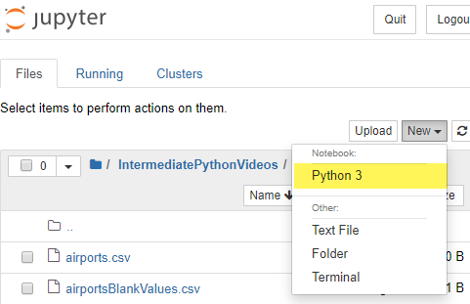
Create a notebook to execute your code
Select New | Notebook: Python from the upper right hand corner of the toolbar to create a new notebook to execute Python code

Slide 4
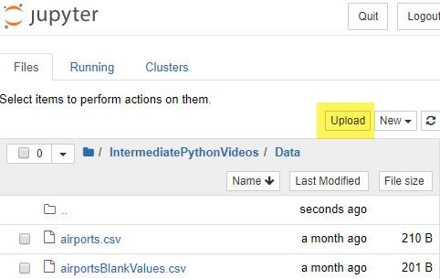
You can upload existing notebooks
Select Upload from the top right corner of the toolbar to upload an existing notebook

Slide 5
Each notebook has one or more cells
Use the toolbar to add and move cells
When you add a cell select a cell type
Code – contain the code to execute
Markdown – Contains descriptive text formatted using Markdown syntax
Raw NB Convert – is formatted as code but cannot be executed
Add cell below
Move cell up/down
Change cell type

Slide 6
You can execute your code one cell at a time
Select Run from the toolbar to run the code in the current cell
Or you can use keyboard shortcuts
<CTRL>+<ENTER> runs the code in the current cell
<SHIFT>+<ENTER> runs the code in the current cell and moves to the next cell
Run code in current cell

Slide 7

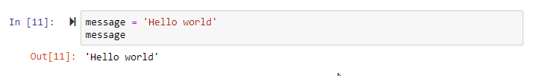
When you run your code the output appears
Output appears below the code cell
If the last line of code in a cell is the name of a variable, Jupyter will display the contents of the variable
Output
Output

Slide 8
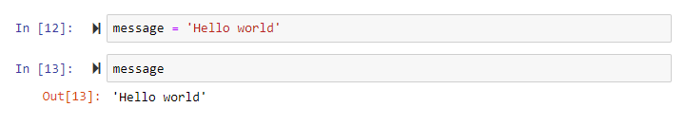
Variables are in scope for the entire notebook
If you run code in a cell that declares a variable or imports a library, subsequent cells you execute can access that variable or library
Select restart the kernel from the toolbar to reset the notebook and start executing code in a notebook over from scratch
restart the kernel

